Slide 1
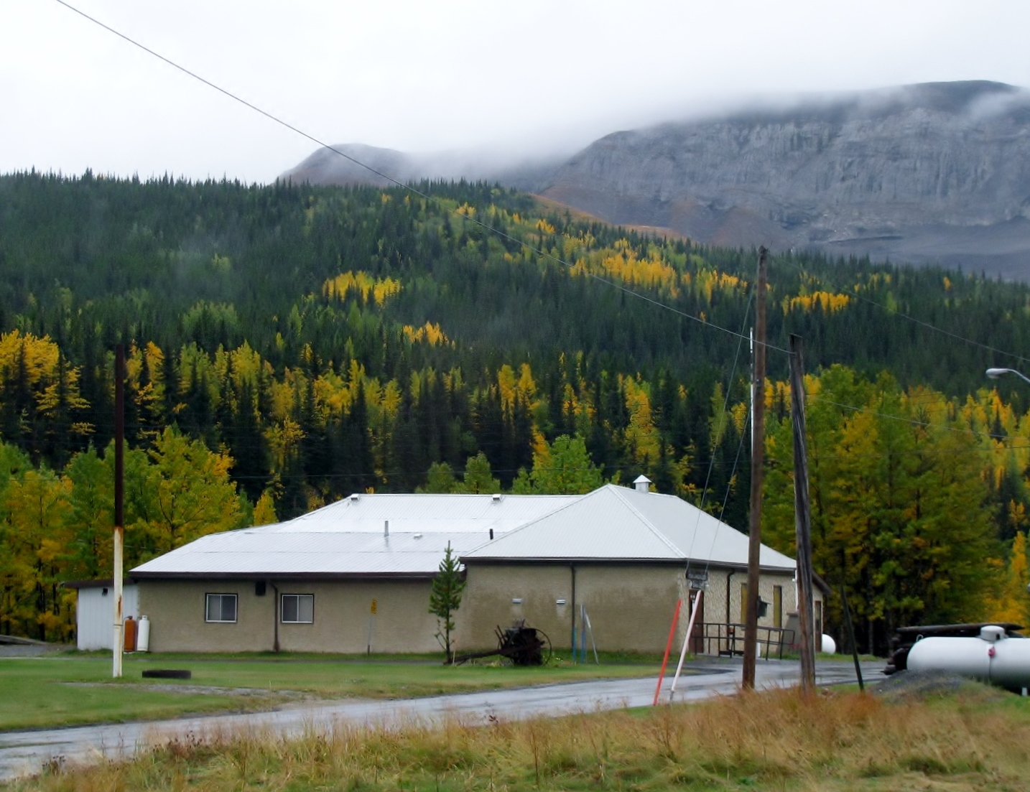

Photos by Lucy Dearing
Slideshow by Mike Rosseker

Slide 2
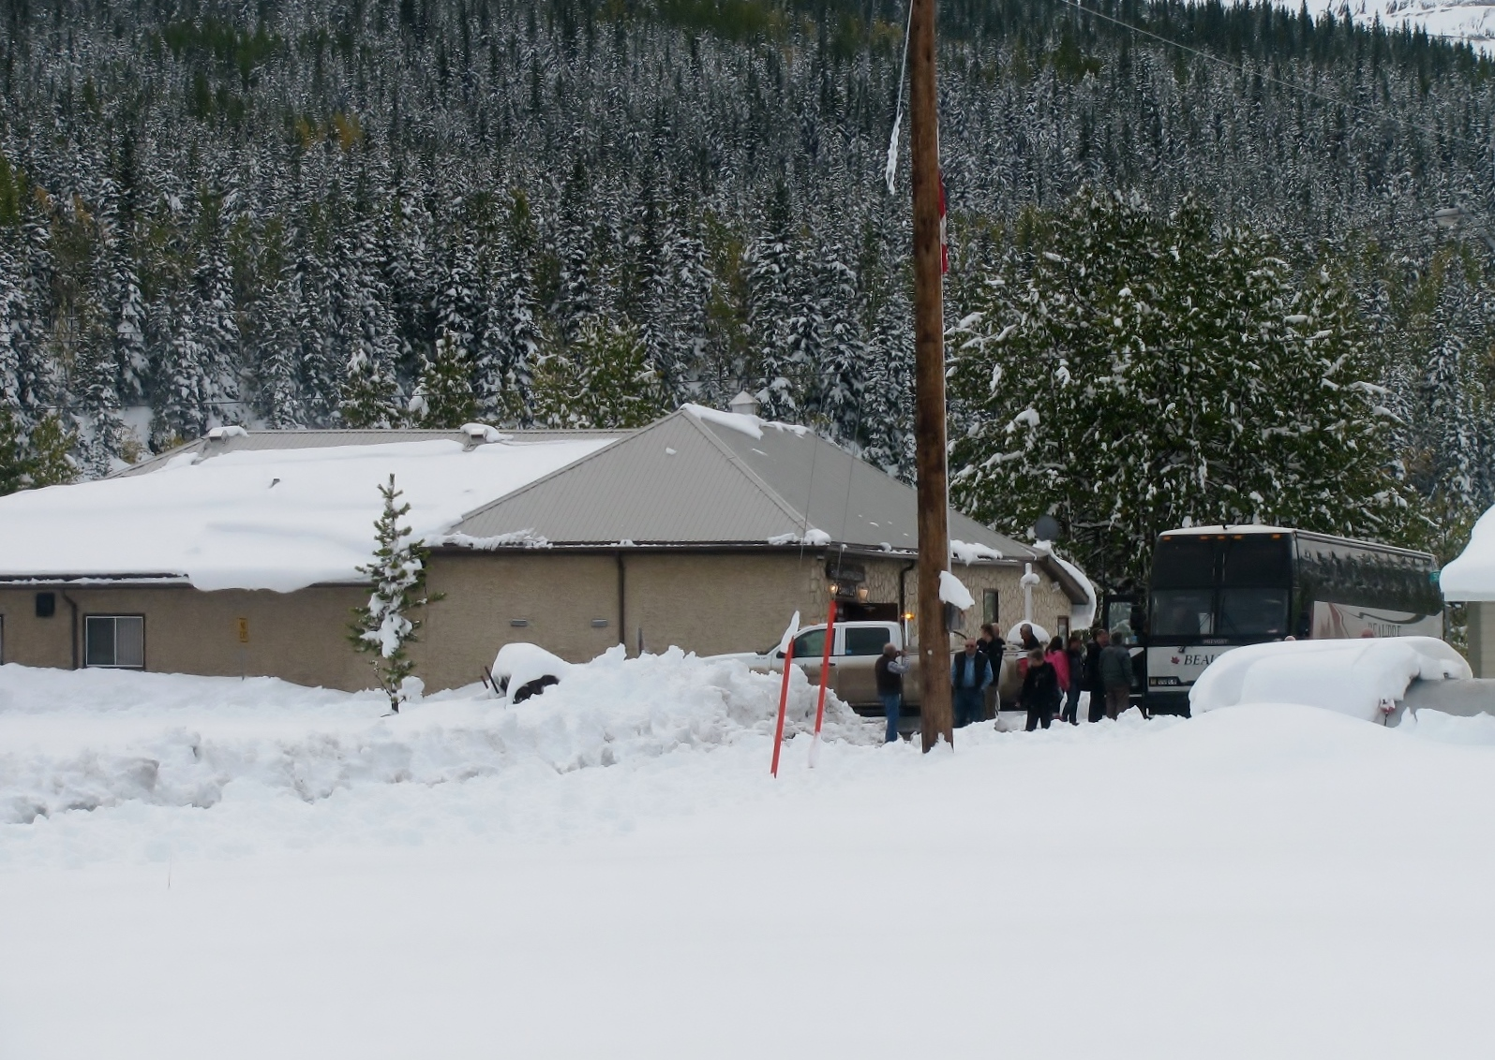
Cadomin September 17, 2017

Slide 3
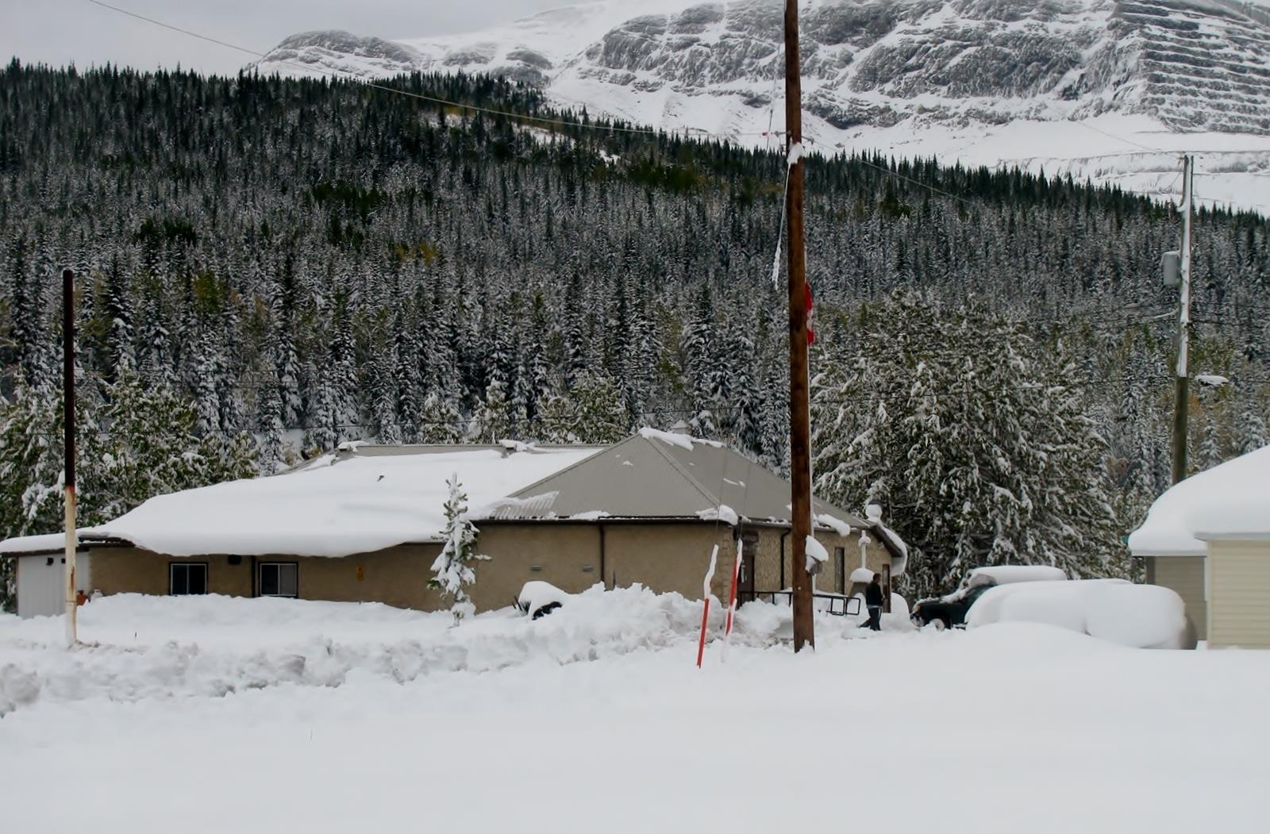
September 17, 2017 – Part 2

Slide 4
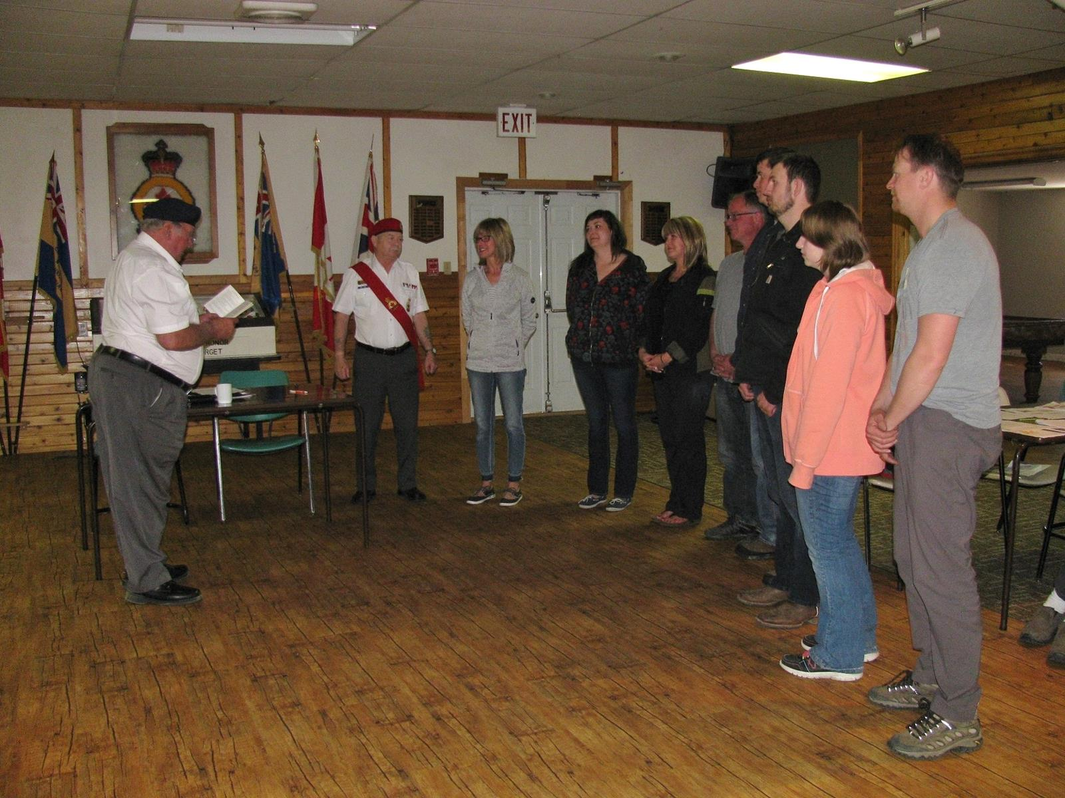
May 2017 Swearing in Ceremony for New Members

Slide 5
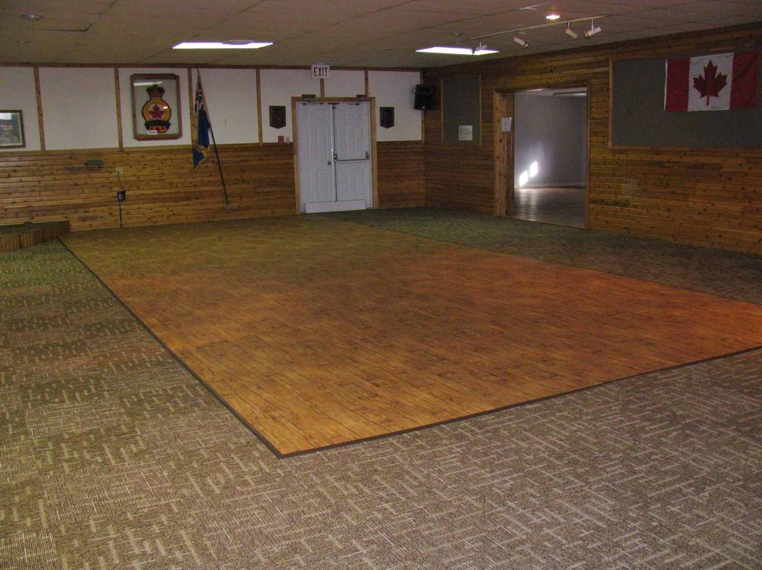
Our new Floor thanks to the hard work of our executive in applying for and receiving a grant to make this happen.

Slide 6
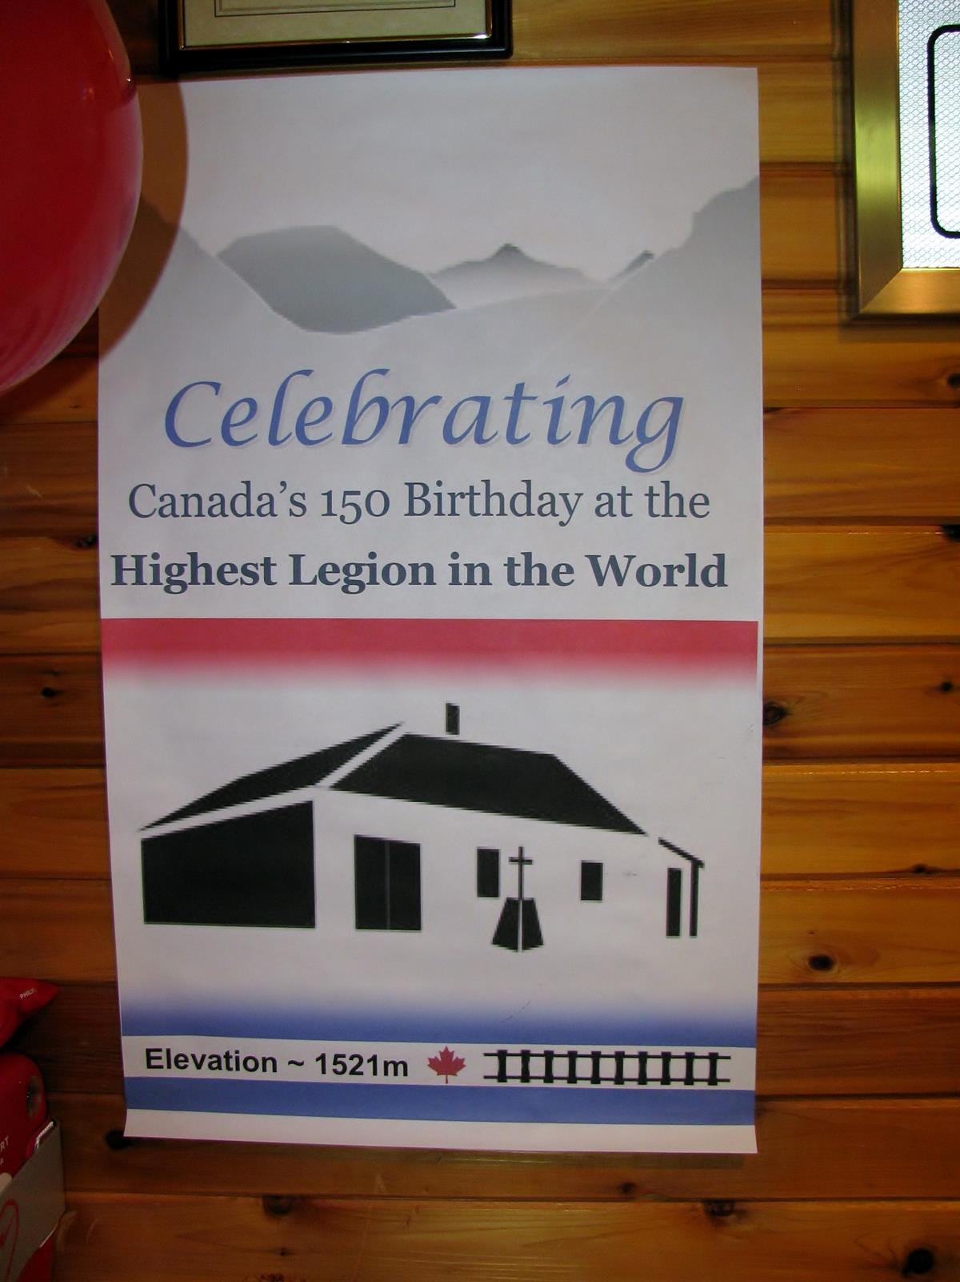
July 2017

Slide 7
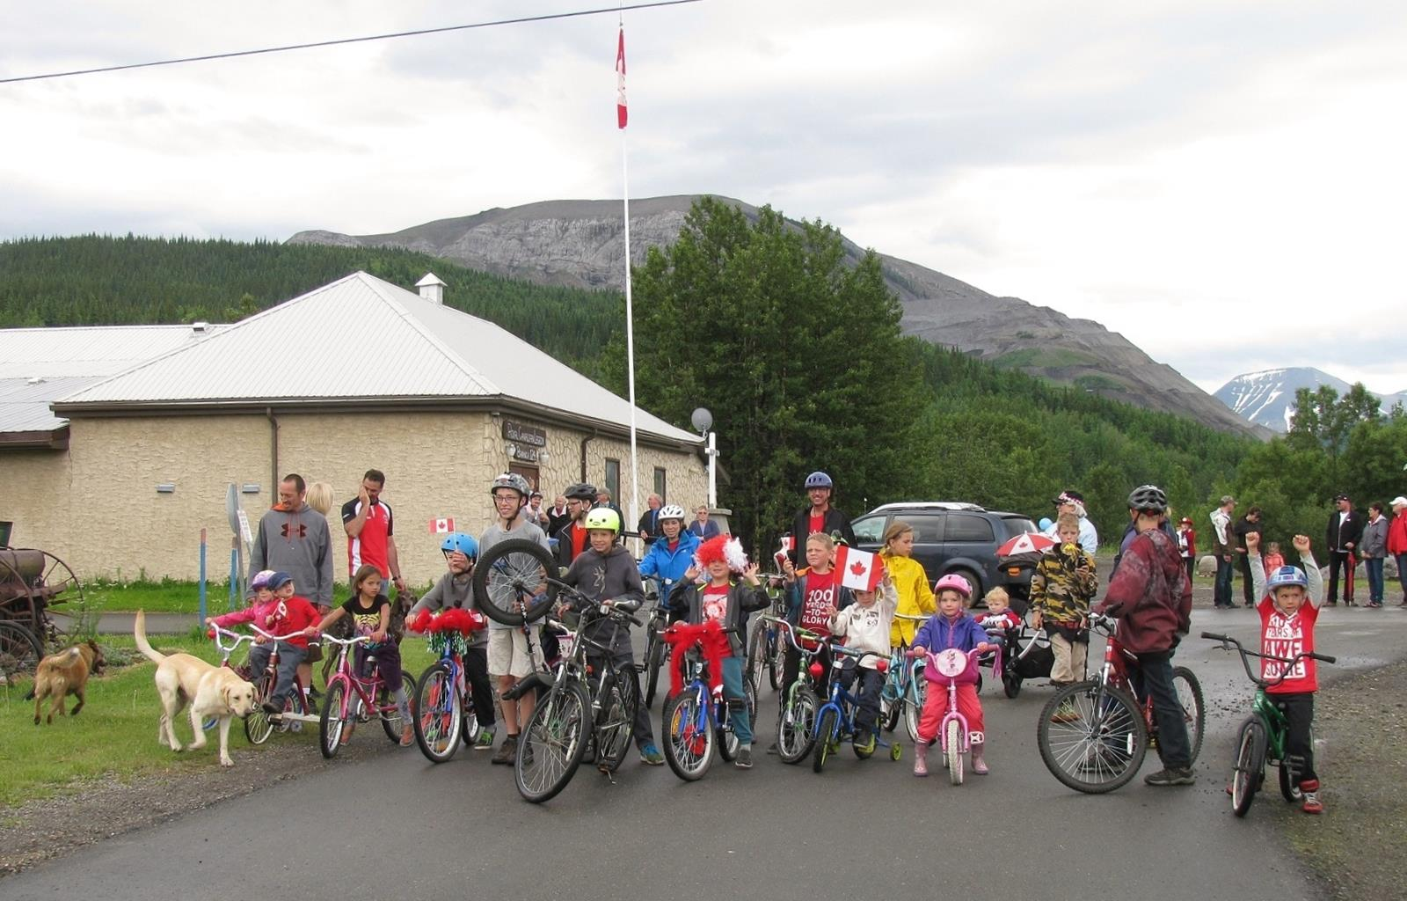
Canada Day Weekend 2017. Kids Bike Parade – the first one in a long time.

Slide 8
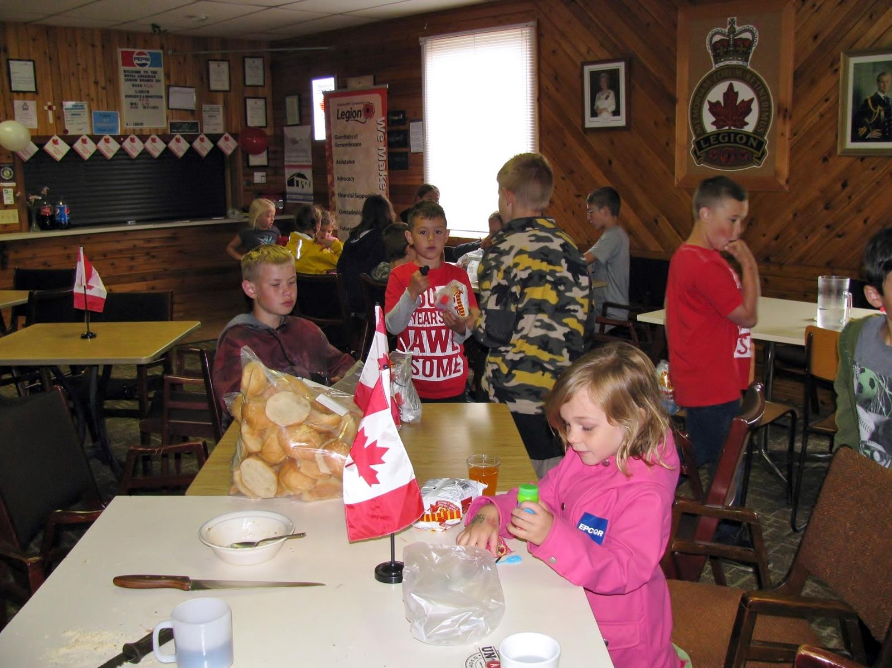
Canada Day Weekend 2017. Kids are always welcome (under parental supervision) at the Cadomin Legion

Slide 9
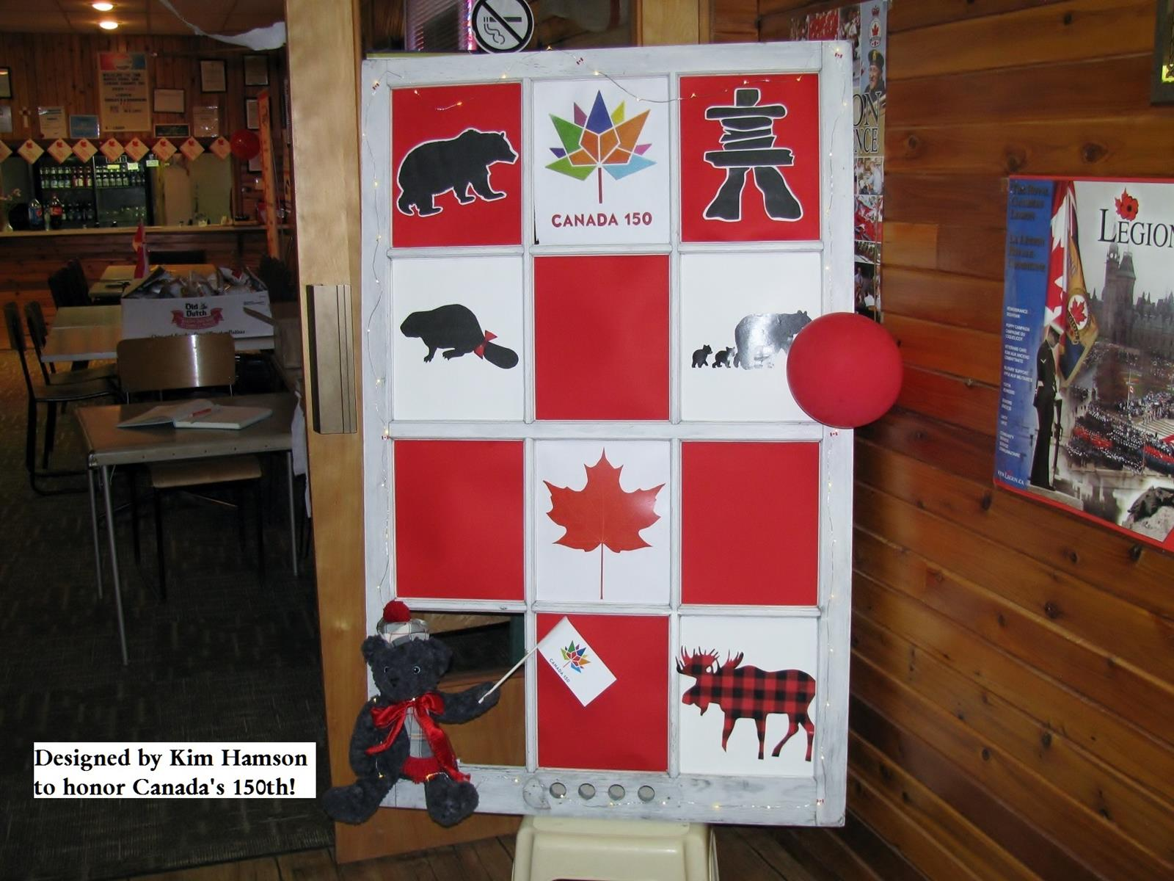
July 2017 - A Canada 150 art project by Kim Hamson. This work was constructed from on old “storm window”

Slide 10
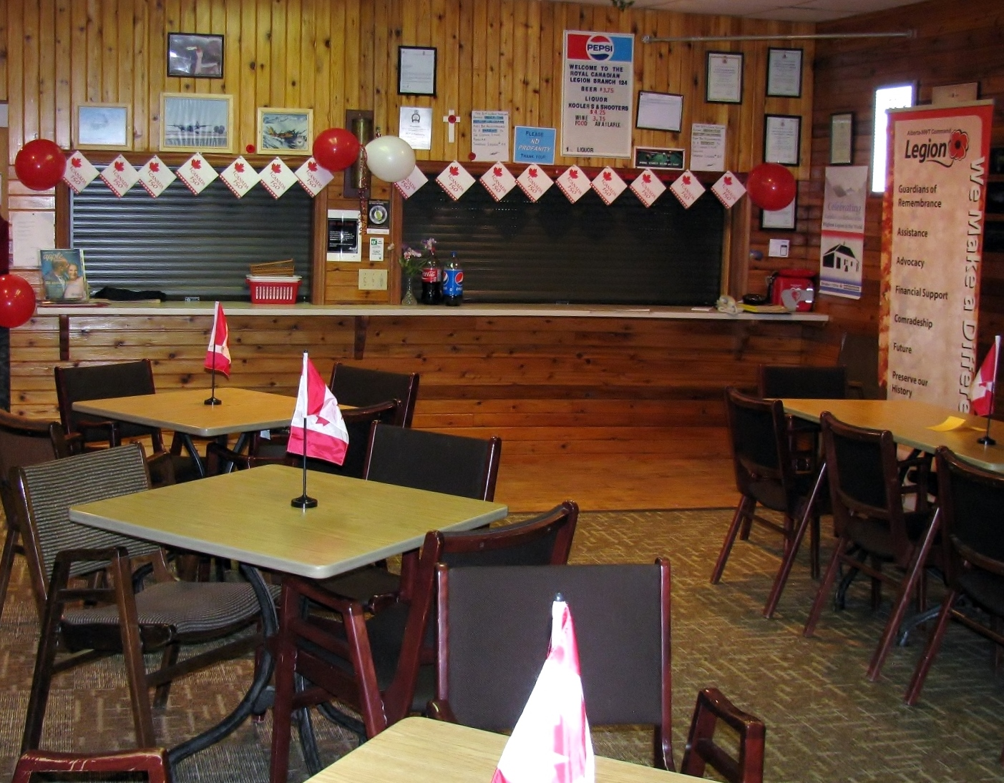
July 2017 - Things are ready to celebrate
Canada’s 150th birthday.

Slide 11
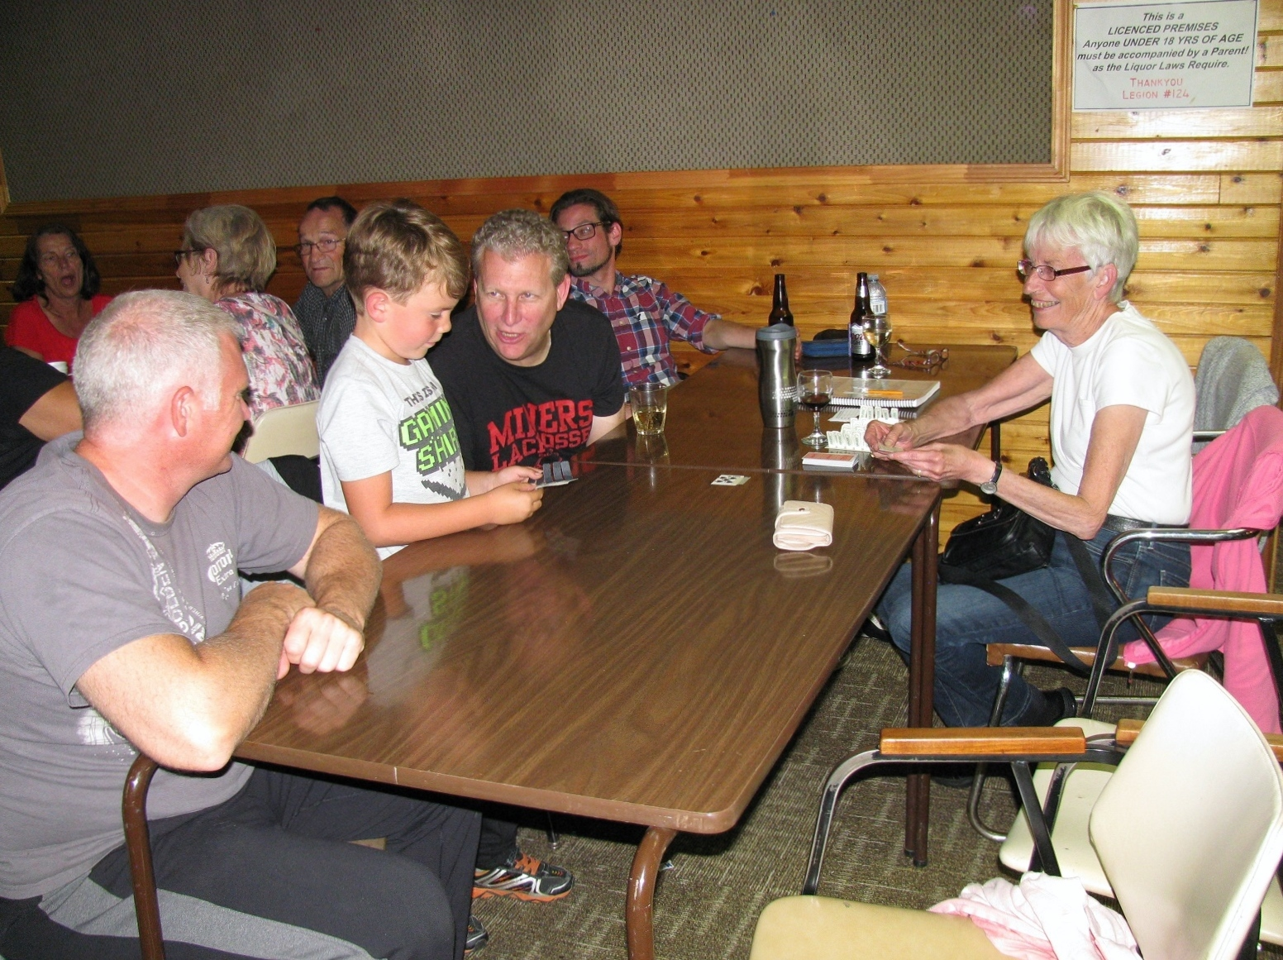
September 2017 – Hip of Beef Night. Always a good time for young and old (President Hamson in the Black T-Shirt

Slide 12
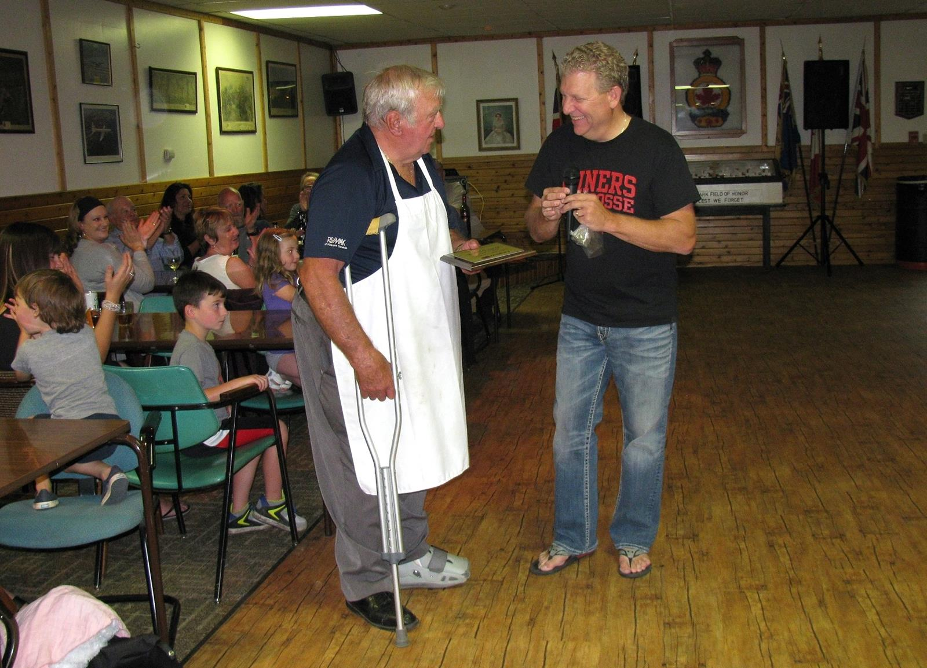
September 2017 - President Hampson presenting a Plaque to Past President Kemble in appreciation of his dedication and service to the Cadomin Legion.

Slide 13
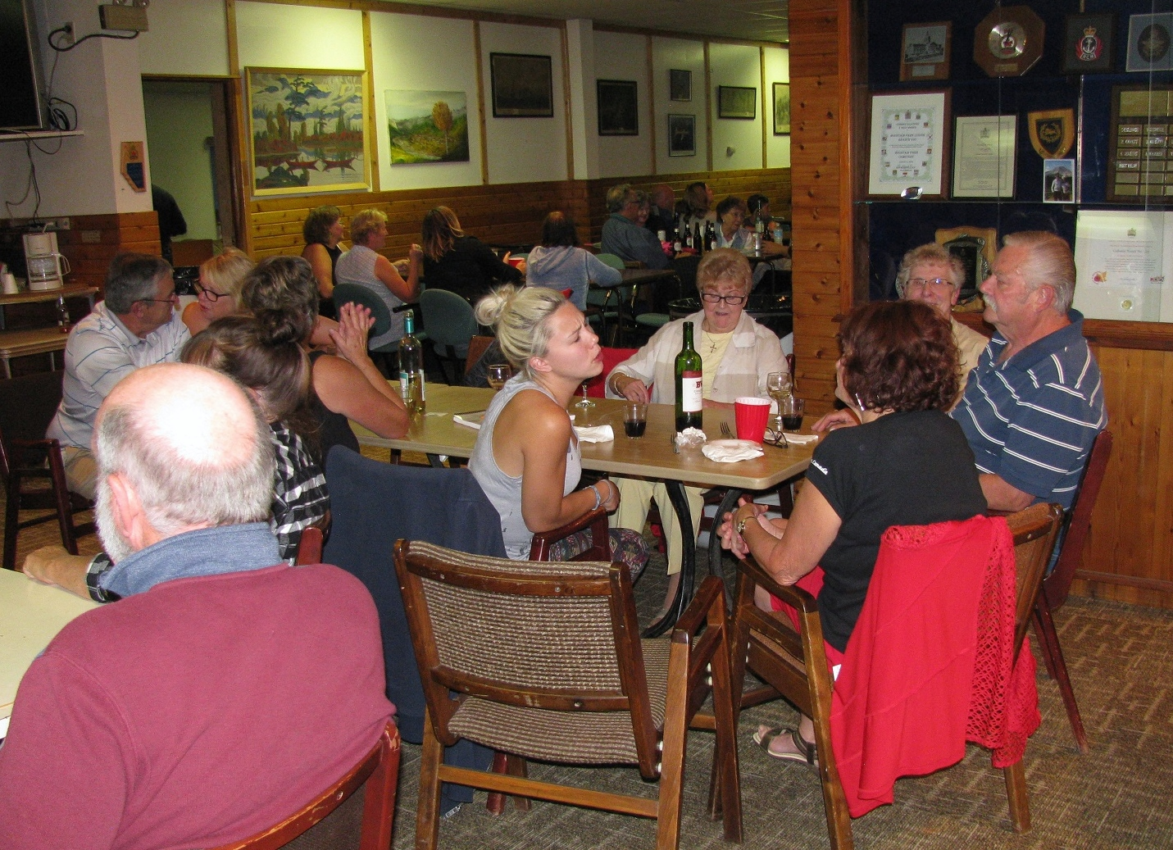
September 2017 – Good Friends, Good Conversation

Slide 14
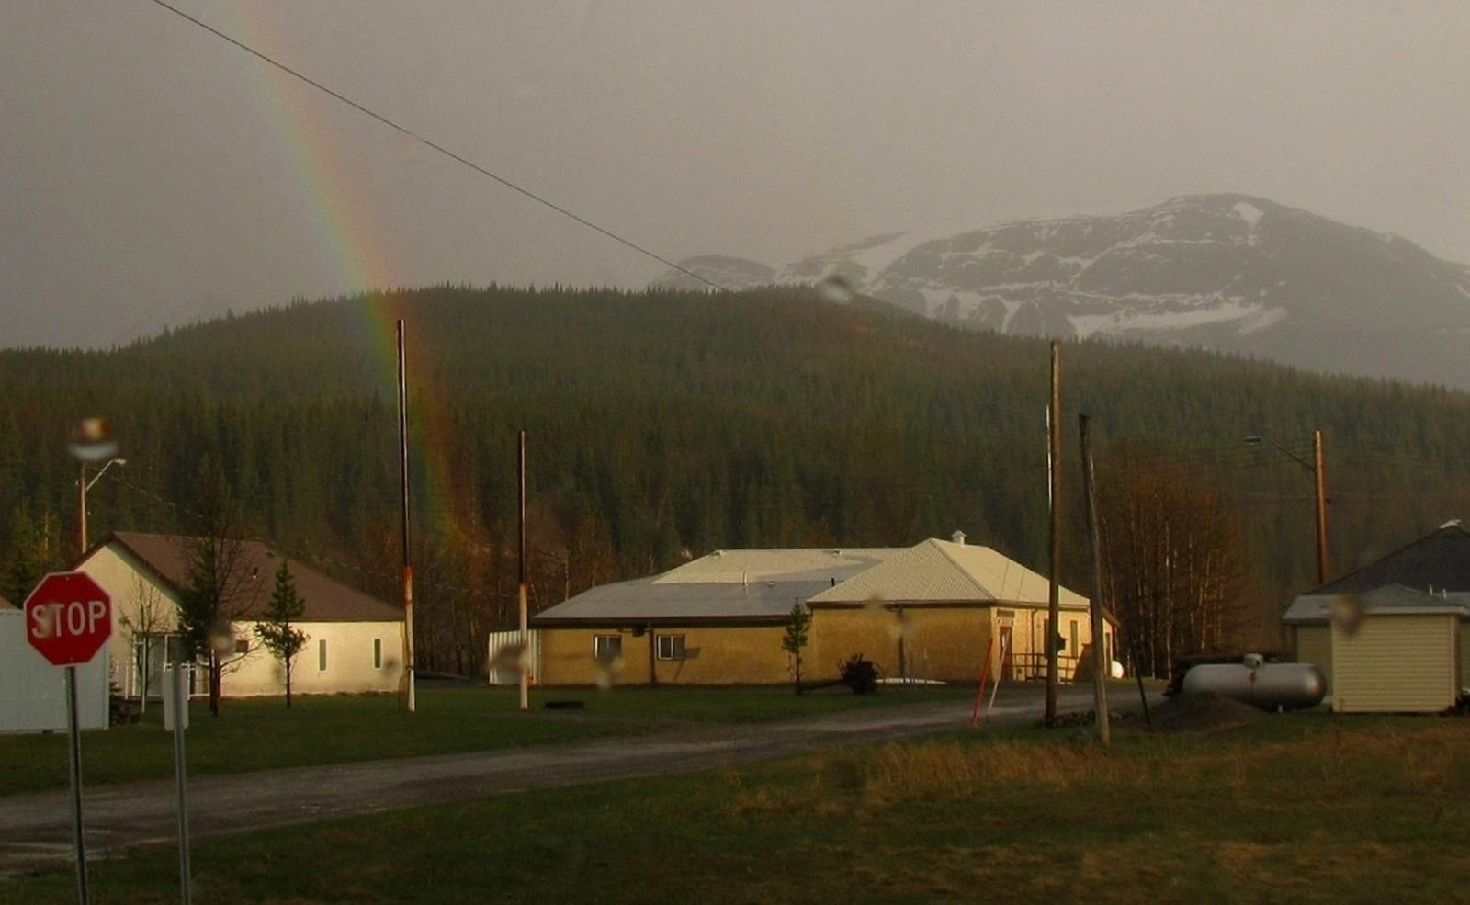
Cadomin Legion May 2014

